Slide 1

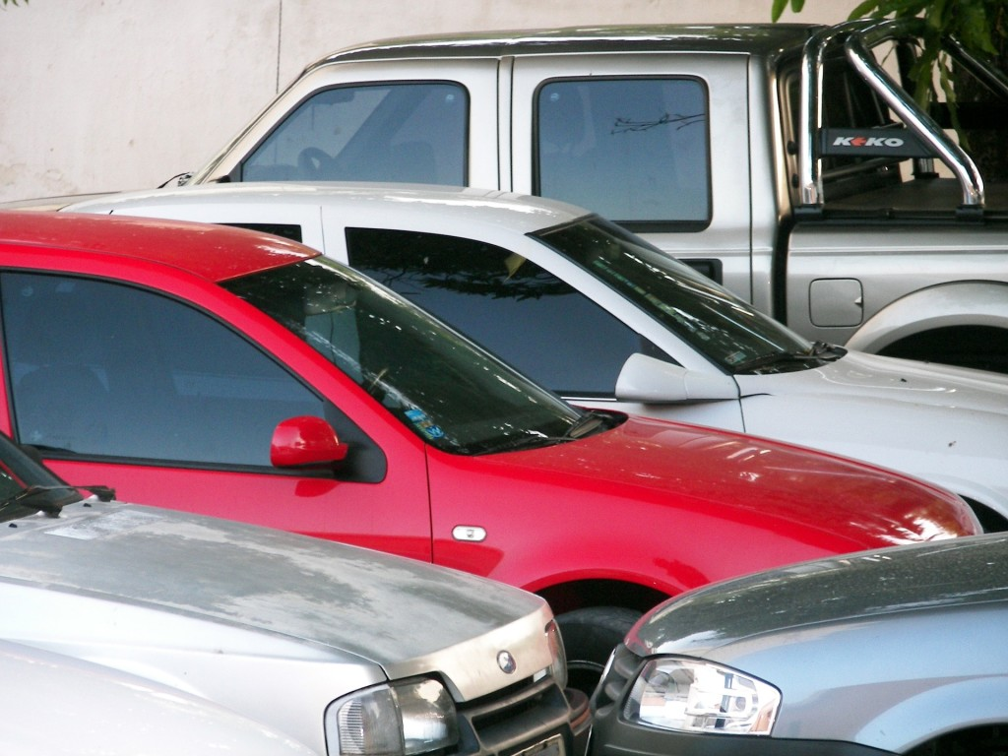
PROJECT PRESENTATION
ON
USED CARS PRICE PREDICTION
BY
V SAMYUKTA
This Photo by Unknown Author is licensed under CC BY
This Photo by Unknown Author is licensed under CC BY-NC

Slide 2
CONTENT
Overview.
Problem Statement.
Problem Understanding.
What is Used Car Price Prediction?
Importance of Used Car price prediction.
Exploratory data analysis.
Visualizations.
Analysis.
Data cleaning steps.
Model Building.
Hyper Parameter Tunning.
Saving the model and predictions from saved best model.
Conclusion.

Slide 3
OVERVIEW:
In this presentation we will be looking at :
How to analyze the dataset of Used Car Price Prediction.
What are the EDA steps in cleaning the dataset.
Overall analysis on the problem.
Model building from cleaned dataset.
Predicting Used Car Price for saved best model.

Slide 4
PROBLEM STATEMENT:
There have been a lot of changes in the car market. Some cars are in demand hence making them costly and some are not in demand hence cheaper. Due to which many are facing problems with their previous car price valuation machine learning models. So, they are looking for new machine learning models from new data. We have to make car price valuation model. This project contains two phase
Data Collection Phase: You have to scrape at least 5000 used cars data. You can scrape more data as well, it’s up to you. more the data better the model In this section You need to scrape the data of used cars from websites (Olx, cardekho, Cars24 etc.) You need web scraping for this. You have to fetch data for different locations. The number of columns for data doesn’t have limit, it’s up to you and your creativity. Generally, these columns are Brand, model, variant, manufacturing year, driven kilometers, fuel, number of owners, location and at last target variable Price of the car. Try to include all types of cars in your data for example- SUV, Sedans, Coupe, minivan, Hatchback.
Model Building Phase: After collecting the data, you need to build a machine learning model. Before model building do all data pre-processing steps. Try different models with different hyper parameters and select the best model

Slide 5
PROBLEM UNDERSTANDING:
There are lots of individuals who are interested in the used car market at some points in their life because they wanted to sell their car or buy a used car. In this process, it’s a big corner to pay too much or sell less than it’s market value.
There are one of the biggest target group that can be interested in results of this study. If used car sellers better understand what makes a car desirable, what are the important features for a used car, then they may consider this knowledge and offer a better service.

Slide 6
What is Used Cars Price Prediction?
The increased prices of new cars and the financial incapability of the customers to buy them, Used Car sales are on a global increase. Therefore, there is an urgent need for a Used Car Price Prediction system which effectively determines the worthiness of the car using a variety of features.

Slide 7
IMPORTANCE OF USED CARS PRICE PREDICTION
The prices of new cars in the industry is fixed by the manufacturer with some additional costs incurred by the Government in the form of taxes. So, customers buying a new car can be assured of the money they invest to be worthy. But due to the increased price of new cars and the incapability of customers to buy new cars due to the lack of funds, used cars sales are on a global increase. There is a need for a used car price prediction system to effectively determine the worthiness of the car using a variety of features. Even though there are websites that offers this service, their prediction method may not be the best. Besides, different models and systems may contribute on predicting power for a used car’s actual market value. It is important to know their actual market value while both buying and selling.

Slide 8
EXPLORATORY DATA ANALYSIS:
As a first step I have scrapped all the required information from cardekho website.
I have imported required libraries and I have imported the dataset which was in excel format.
Then I did all the statistical analysis like checking shape, nunique, value counts, info etc…..
I have also dropped Unnamed:0, registration year as I found they are of no importance
Next as a part of feature extraction I converted the data types of all the columns and I have extracted useful information from the raw dataset. Thinking that this data will help us more than raw data.

Slide 9
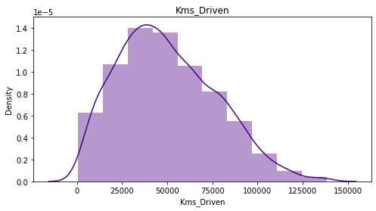
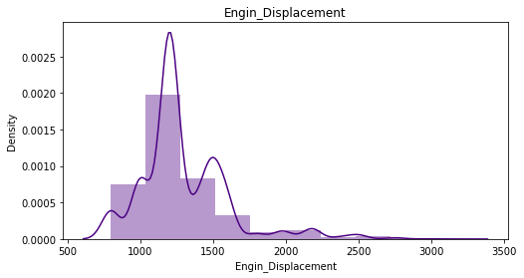
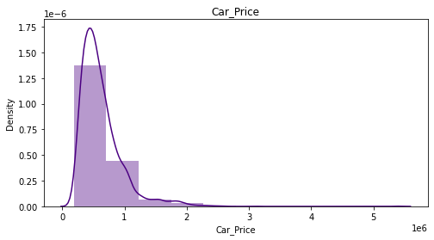
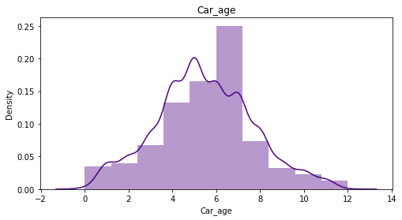
VISUALIZATION OF NUMERICAL COLUMNS:

Slide 10
OBSERVATIONS:
Engine_Displacement is having wide spread of data between 500-3500 and data is right skewed.
Most of the cars have engine displacement between 1000-1300.
and car_price is also right skewed. however, car_price skewness will not be removed as it is my target column.
Most of used car are 7 year old.

Slide 11
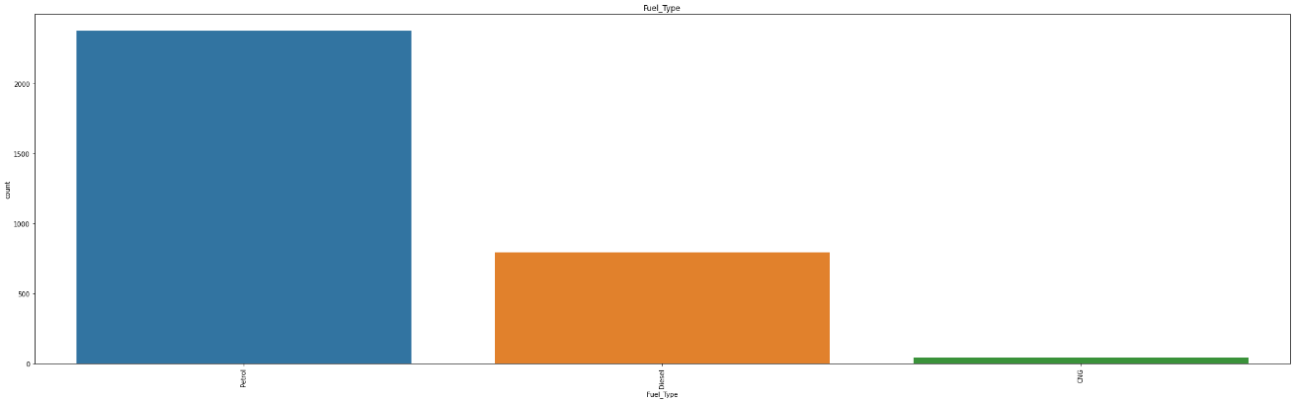
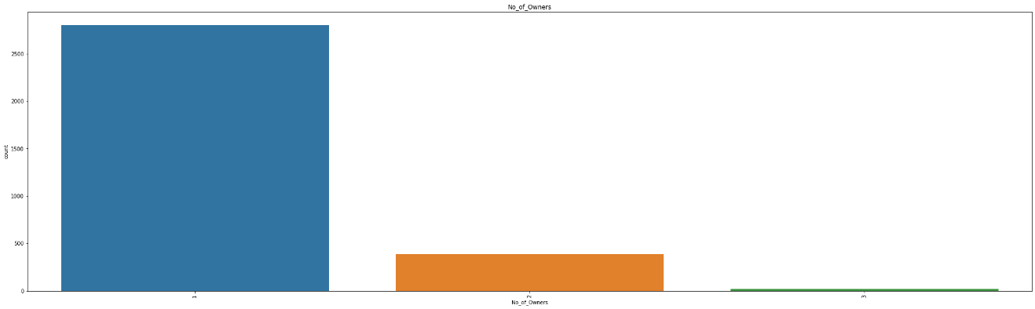
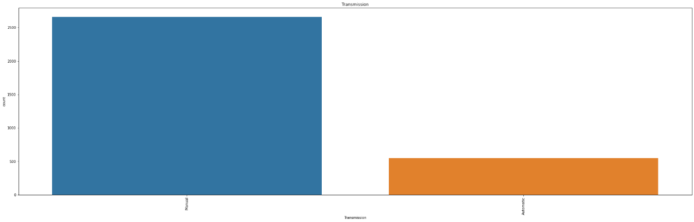
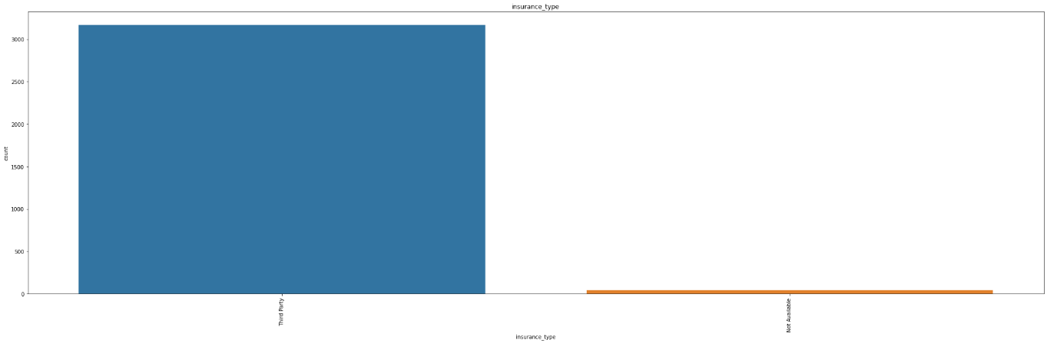
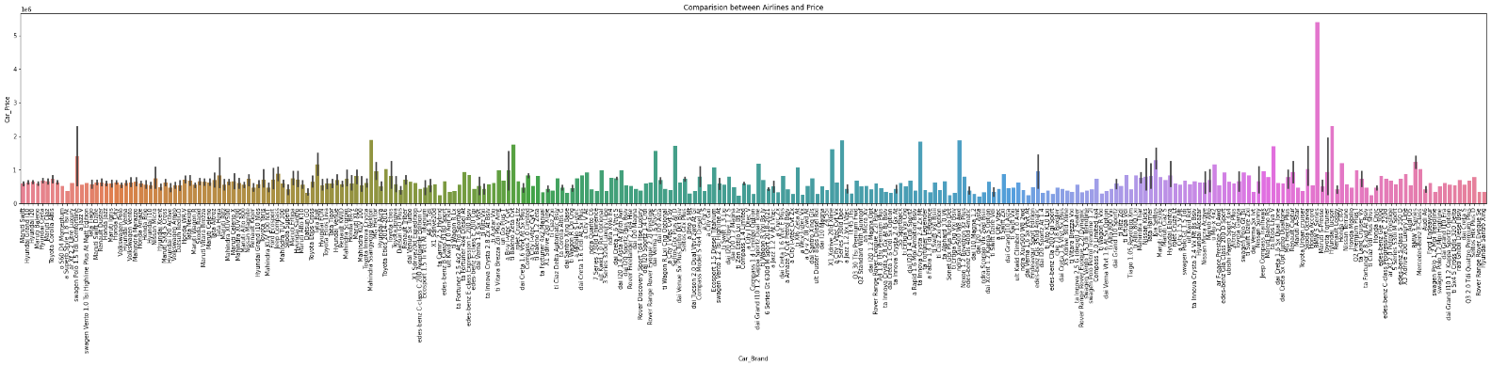
VIZUALIZATION OF CATEGORICAL COLUMNS:

Slide 12
OBSERVATIONS:
Most of the used cars run on petrol and very few on CNG
Most of the used cars belong to single owner
Most of the used cars have manual transmission.
Almost all used cars have third party insurance.
BMW 5 series has highest price.

Slide 13
ANALYSIS:
I have used dist plot to check the skewness in numerical columns.
I have used bar plot for each of categorical feature that shows the relation with the median car price for all the sub categories in each categorical feature.

Slide 14
DATA CLEANING STEPS:
Data has been scrapped from cardekho website so we have to clean it for our convenience.
In my datasets I found outliers and also skewness.
To remove outliers I have used IQR method.
To encode the categorical columns I have use Label Encoding.
Use of Pearson’s correlation coefficient to check the correlation between dependent and independent features.
Also I have used standardization. Then followed by model building with all regression algorithms.

Slide 15
MODEL BUILDING:
Since Car_price is the target and is a continuous column so given problem is regression problem. And I have used all regression algorithms to build my model. By looking into the difference of r2 score and cross validation score I found , XGB Regressor as a best model with least difference. Also to get the best model we have to run through multiple models and to avoid the confusion of overfitting we have to go through cross validation. Below is the list of regression algorithms I have used in my project.
RandomForest Regressor
XGB Regressor
ExtraTrees Regressor
GradientBoosting Regressor
DecisionTree Regressor

Slide 16
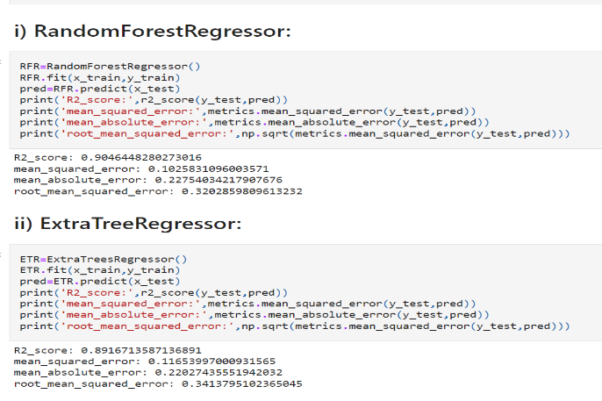
RANDOMFOREST REGRESSOR AND EXTRATREE REGRESSOR:

Slide 17
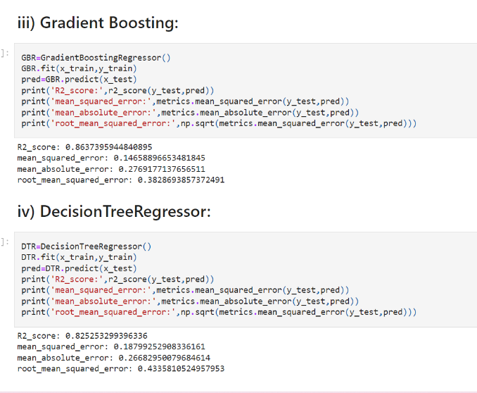
GRADIENTBOOSTINGREGRESSOR AND DECISIONTREE REGRESSOR:

Slide 18
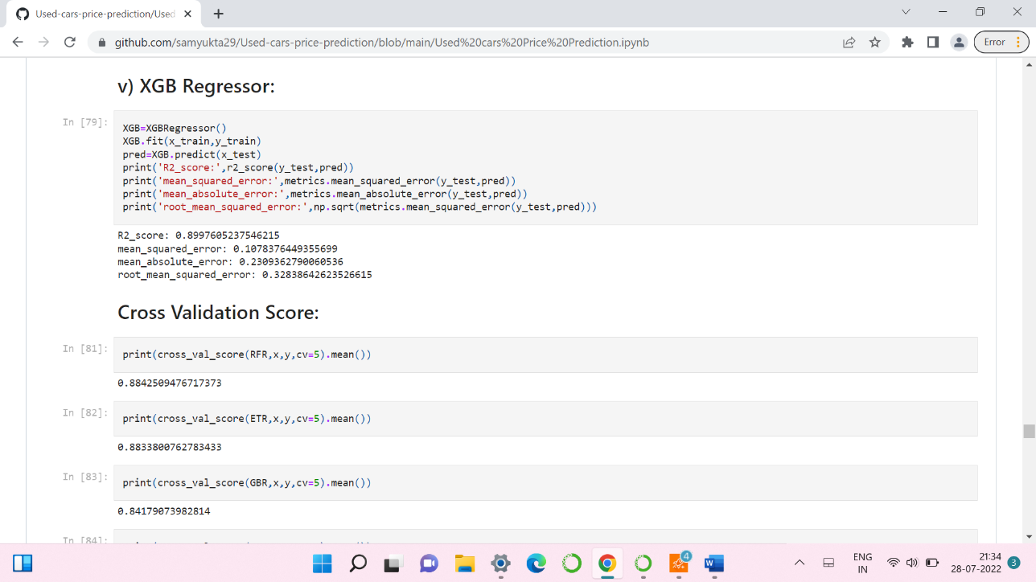
XGB REGRESSOR
XGB Regressor has given 89.9% accuracy.
By looking into the difference of model accuracy and cross validation score I found XGB Regressor as the best model.

Slide 19
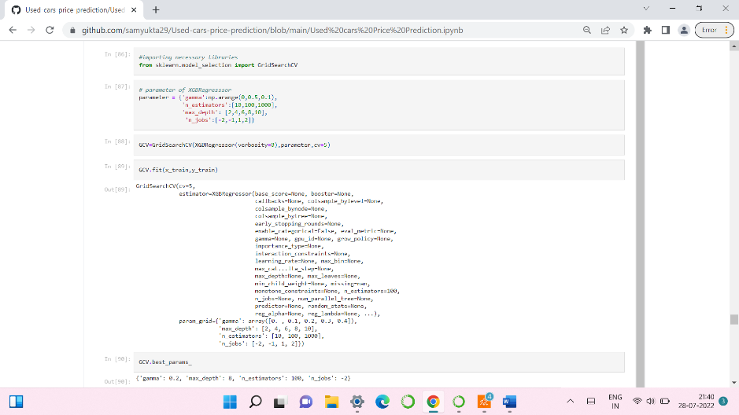
HYPER PARAMETER TUNNING:

Slide 20
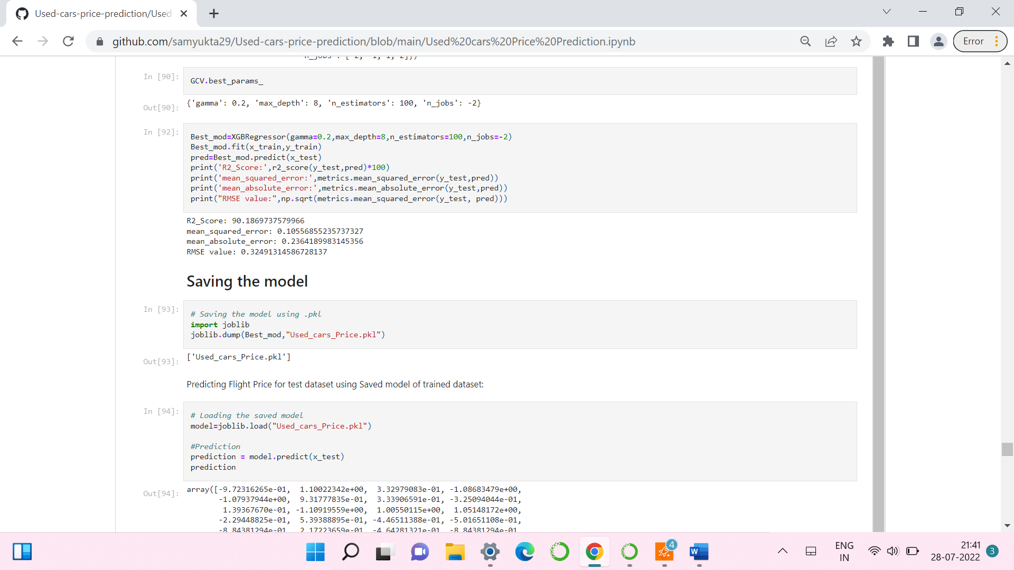
HYPER PARAMETER TUNNING:
I have choosed all parameters of XGB Regressor, after tunning the model with best parameters I have incresed my model accuracy from 89.9% to 90.18%. Also mse and rmse values has reduced which means error has reduced.

Slide 21
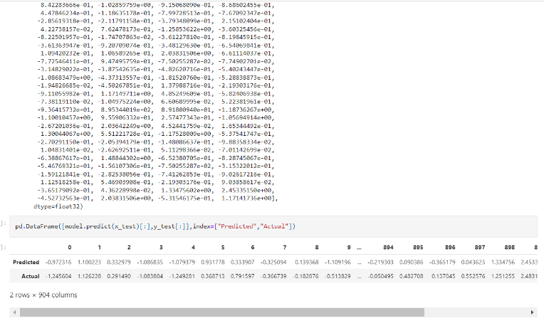
SAVING THE MODEL AND PREDICTIONS USING SAVED MODEL:
I have saved my best model using .pkl as follows.
Now after saving the best model, loading my saved model and predicting the test values.

Slide 22
CONCLUSION:
In this project report, we have used machine learning algorithms to predict the used car price. We have mentioned the step by step procedure to analyse the dataset and finding the correlation between the features.
Thus we can select the features which are correlated to each other and are independent in nature. The power of visualization has helped us in understanding the data by graphical representation it has made me to understand what data is trying to say.
Data cleaning is one of the most important steps to remove unrealistic values and unnecessary values.
These feature set were then given as an input to five algorithms and a hyper parameter tunning was done to the best model and the accuracy has been improved. Hence we calculated the performance of each model using different performance metrics and compared them based on these metrics.
Then we have also saved the best model and predicted the car price.

Slide 23


